Slide 1

Data-Driven Workflow for Predicting Stock Trends in Dating App Companies
Scottie
20241007

Slide 2
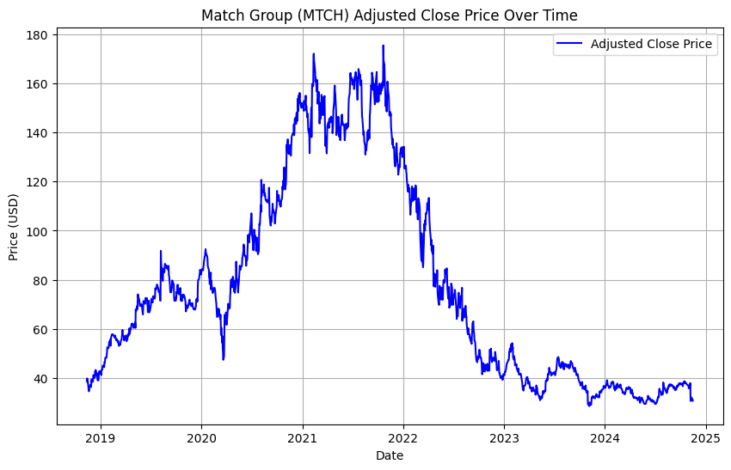
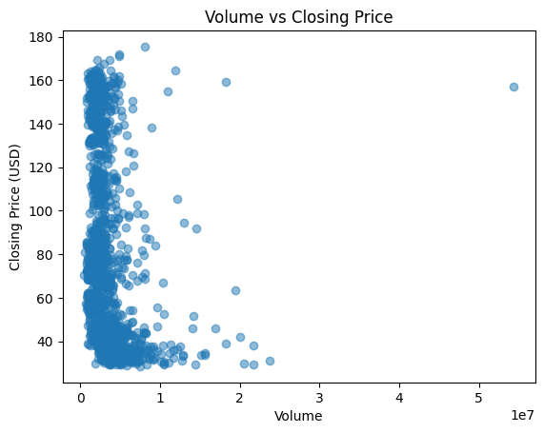
Data (https://finance.yahoo.com/quote/MTCH/)
Date: The specific date of the trading day.
Adj Close: The adjusted closing price of the stock, taking into account dividends andstock splits.
Close: The closing price of the stock on the trading day.High: The highest price reached during the trading day.Low: The lowest price reached during the trading day.
Open: The opening price of the stock on the trading day.
Volume: The number of shares traded during the trading day.
IDA Template

Slide 3
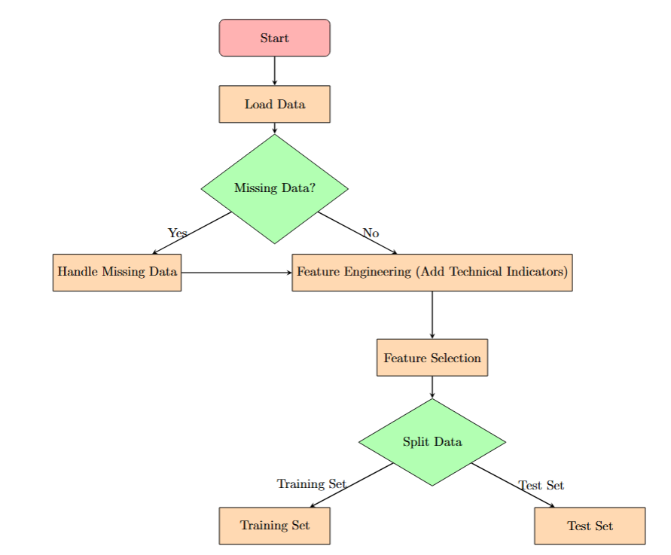
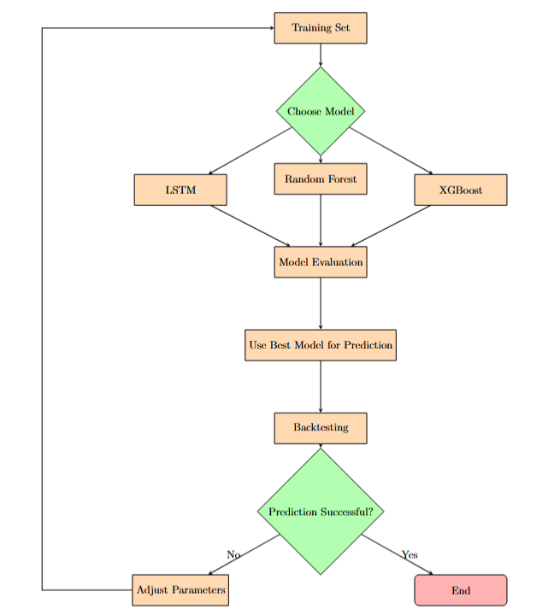
Flow chart
IDA Template

Slide 4
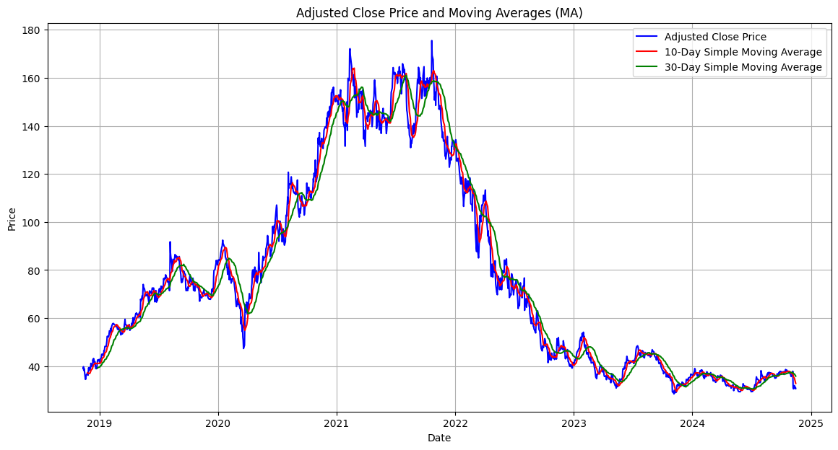
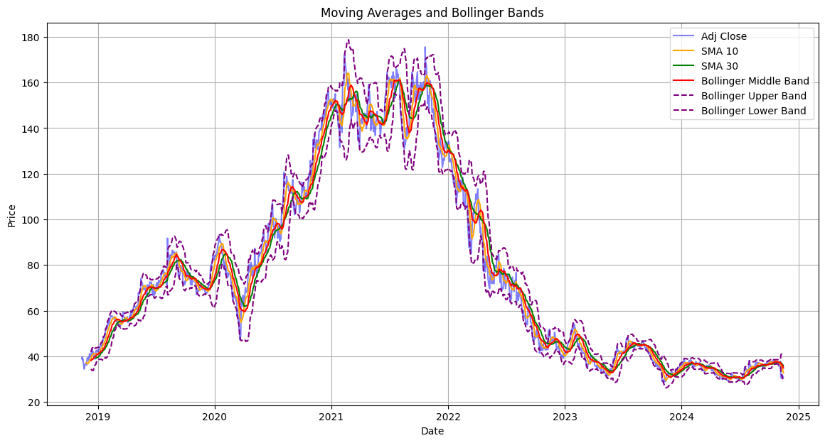
Feature Engerineering
MA
Bollinger Bands
IDA Template

Slide 5
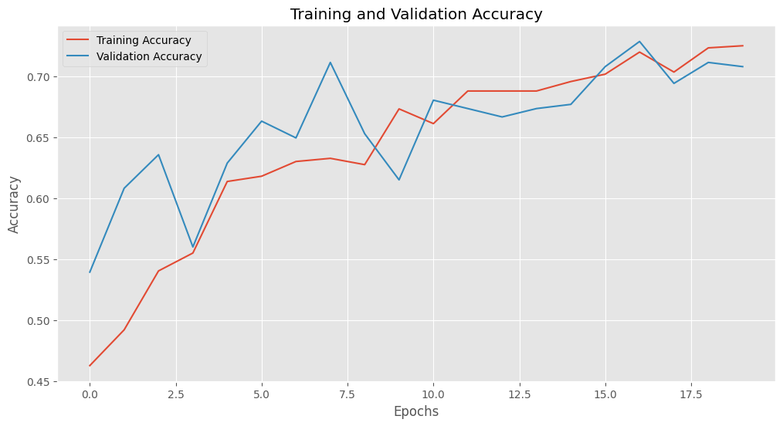
Result
LSTM acc : 0.7079 (test set)
IDA Template

Slide 6
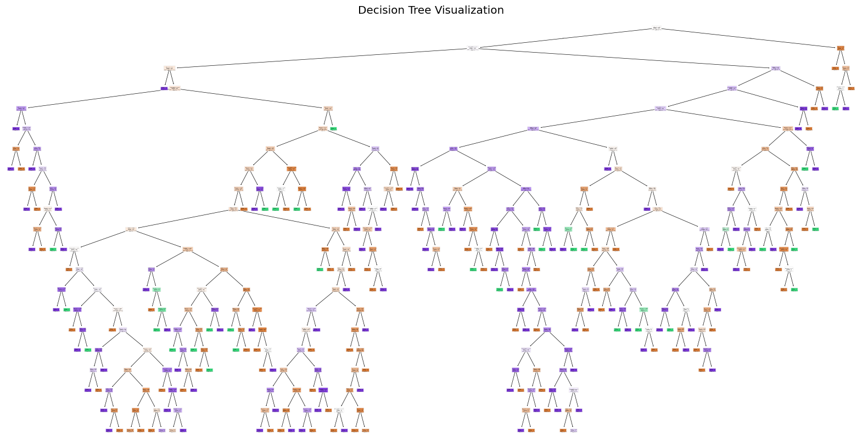
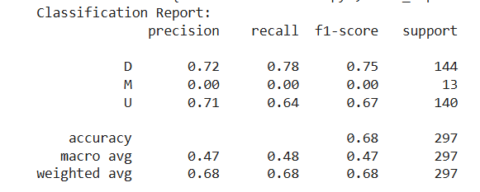
Result
IDA Template

